Slide 1
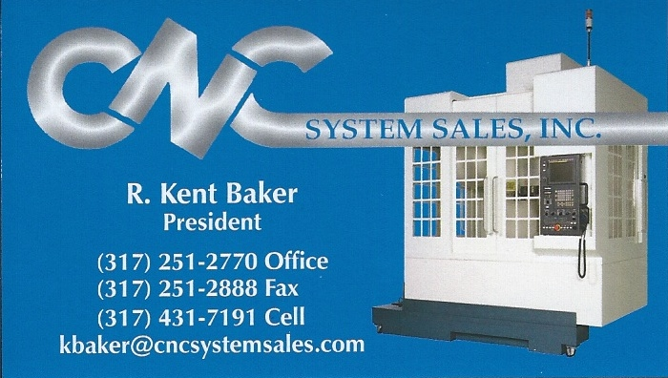
Agile Smart Machining
Adapting Industrie 4.0
表單編號：MG-40-85

Slide 2
Outline
INDUSTRIE 4.0
Smart machining
ART – The Solution
ART Functions
  Reliability Maintenance
  Energy Management
  Manufacturing Process
Conclusion

Slide 3
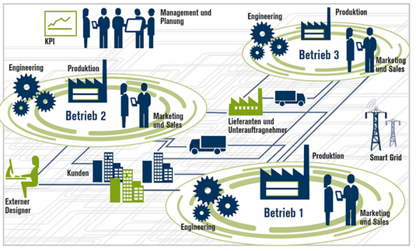
INDUSTRIE 4.0
4th Industries Revolution = New Automation
  Reliability (SMT) +TQM
Horizontal value creation network (source: HP 2013)

Slide 4
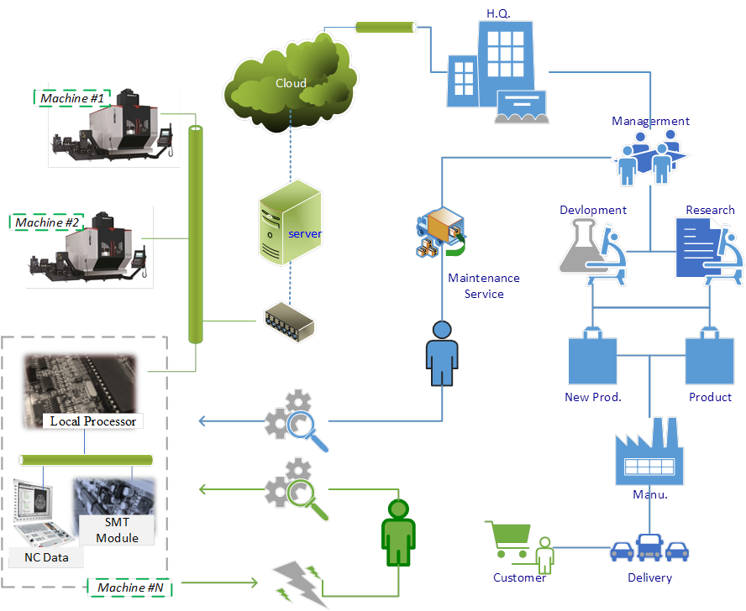

Smart Machining
Smart Machining Technology ( SMT )
  Upmost productivity and machining accuracy
Reliability + TQM
Automation
( 7/24-Flex.)
The I4.0 Blueprint in AXILE

Slide 5





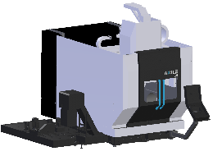
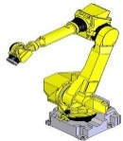

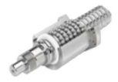
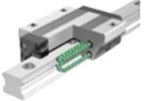

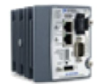
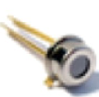

ART – The Solution
Basic
Pro
Data-to-Information
-Data analytics
AXILE cloud
Analysis
RM
EM
MP
Decision Support System
- Remote visualization
User platform
Data application
TQM
TQM
ERP
Request & answer
ERP
MES
MES
Management
Management
Data processor
Data processor
Real-time Monitoring
Database
Database
Monitor
Monitor
Field /
Workshop
Data Acquire
Machines
Machines
Internet of Things (IoT)
- Collection
Components
Components
Detector
Detector
Notes:
MES（Manufacturing Execution System , 製造執行系統）

Slide 6
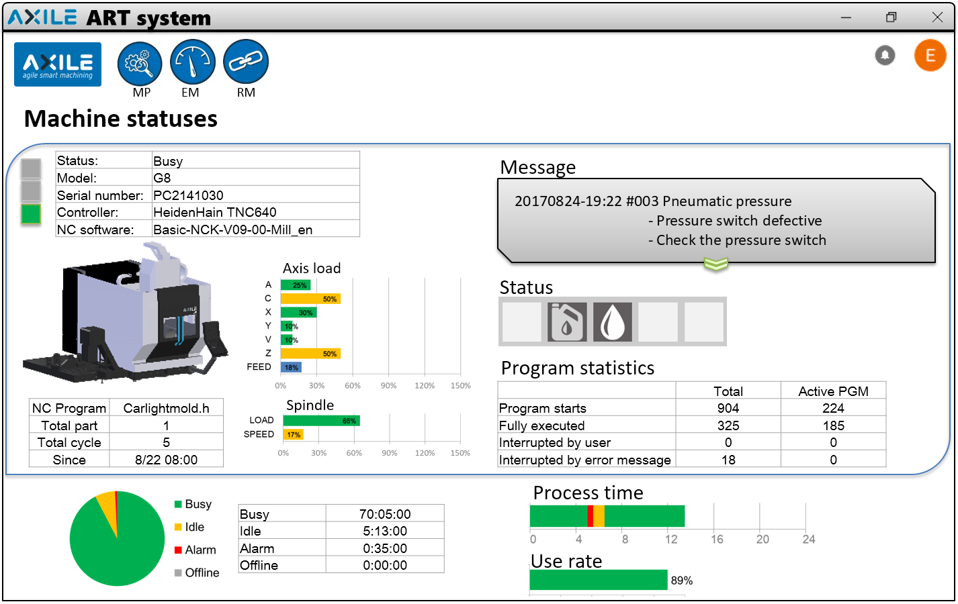
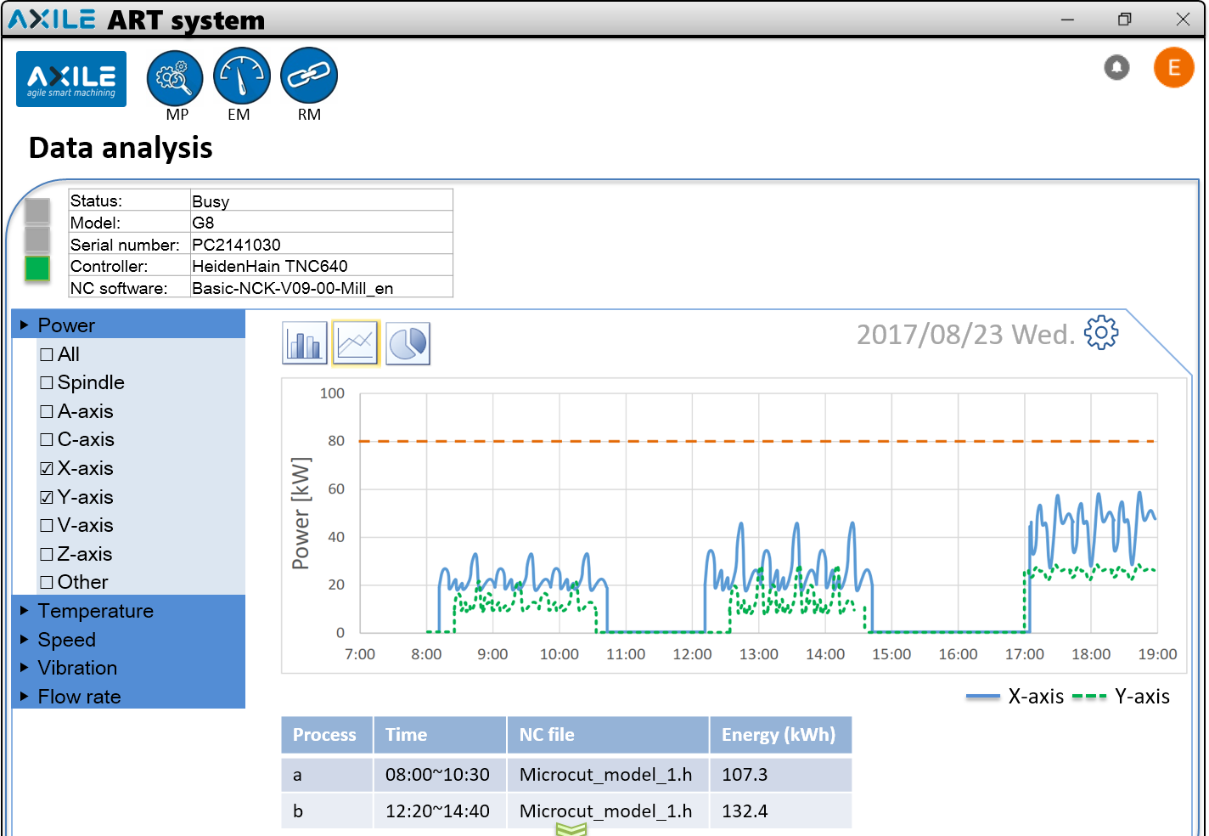
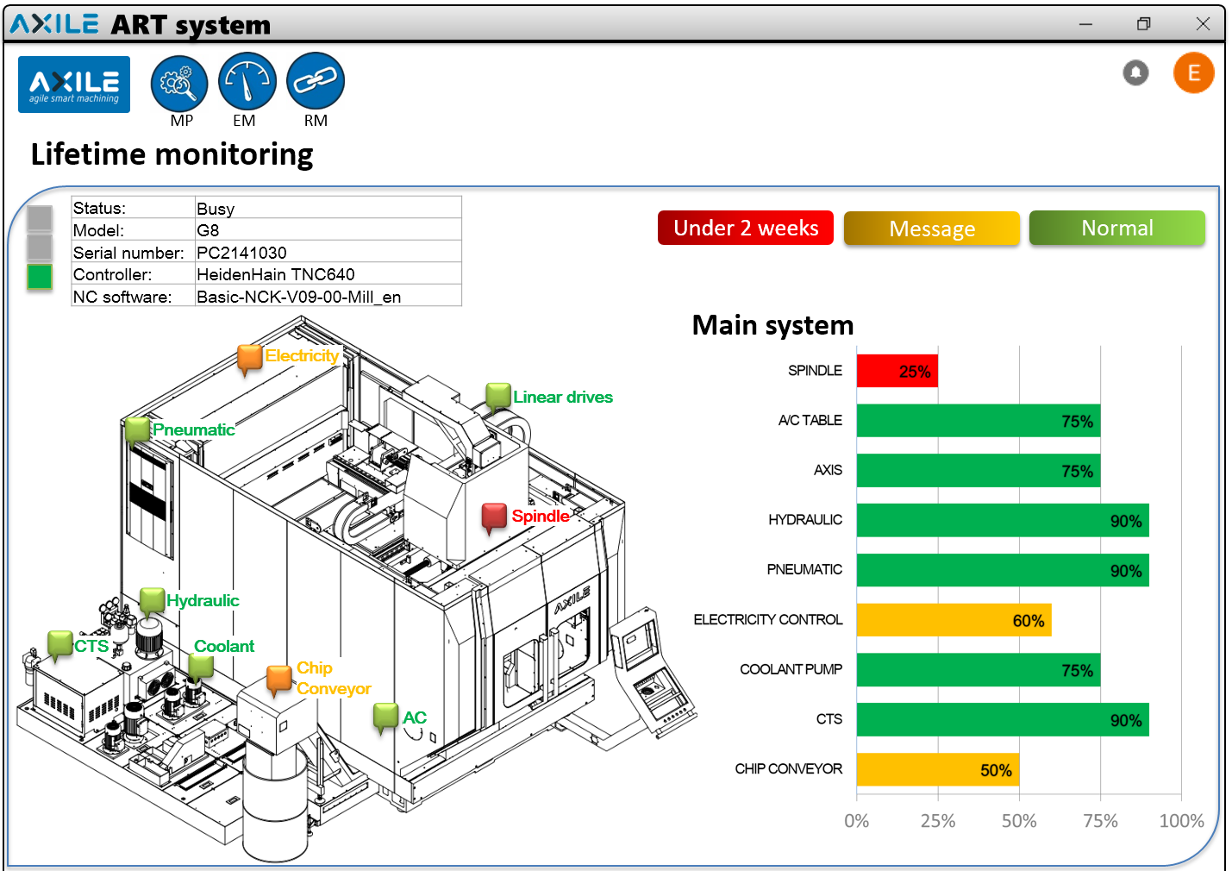
ART Features
 | Basic Standard | RM Option | EM Option | MP Option
Real-time data | 
Data collect & storage | 
Historical data explorer | 
Utilization rate |  |  |  | 
Production process monitoring |  |  |  | 
Energy prediction (basic) |  |  | 
Energy prediction (pro)* |  |  | 
Consumables monitor |  | 
Condition diagnosis |  | 
Lifetime monitoring (basic) |  | 
Lifetime monitoring (pro)* |  | 
NC program optimization* |  |  |  | 
Crash protection (Software) |  |  |  | 
Crash protection (Hardware) |  |  |  | 
* Por. function, calculated by AXILE cloud

Slide 7
ART – The Solution
Reliability evaluation mechanism
  Ensure the Machine at best condition
Remaining lifetime
Real-time report
Decision Support System
Lifetime prediction system
Diagnosis system
Sensing mesh
Process
Real-time monitoring

Slide 8
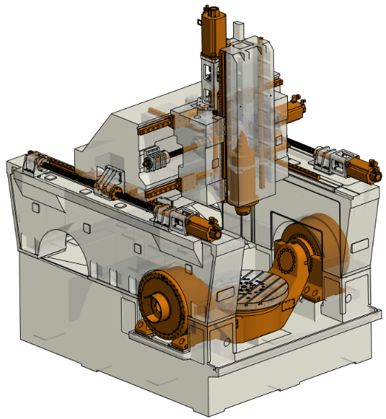
ART Benefits
Production
Machines production status transparency
Maintenance and Service
Error message prior to broken
Increased utilization and asset availability
Increased machine productivity
Lower warranty expenses / increase service efficiency
Reduce inventory of spare parts
Equipment working when needed
Abnormal condition notice for faster reaction
ART
RM
MP
EM
Production
Maintenance & Service

Slide 9

How ART System Support the Management
Simple access to see your machine
statuses within a worldwide available
platform
Management tool provide a summary of workshop for Production manager
Machine overview provide a summary of machine states for Machine operator
Data analysis provide user define data analysis for Maintenance & Engineer
Lifetime monitoring & Diagnosis System provide machine lifetime indicator for Maintenance manager

Slide 10
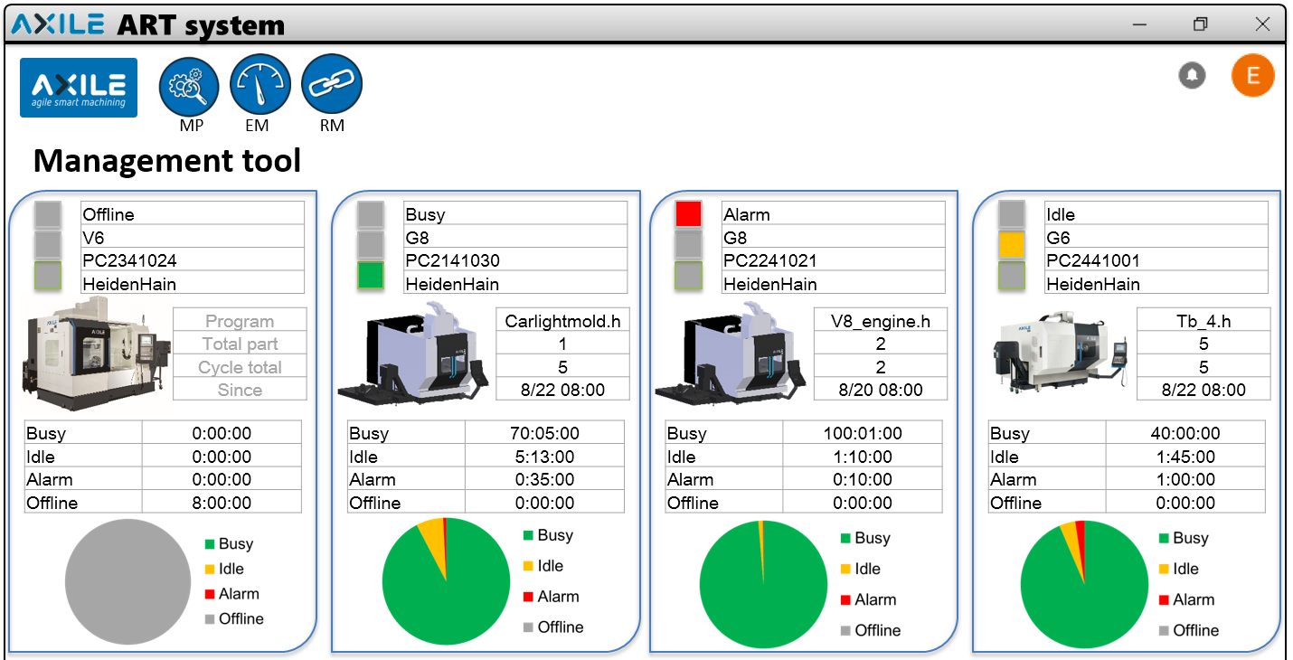
Management Tool
Machine
NC program
Utilization rate

Slide 11
Machine Overview
Error message
Real-time data
Utilization rate
Daily view
NC Program info

Slide 12
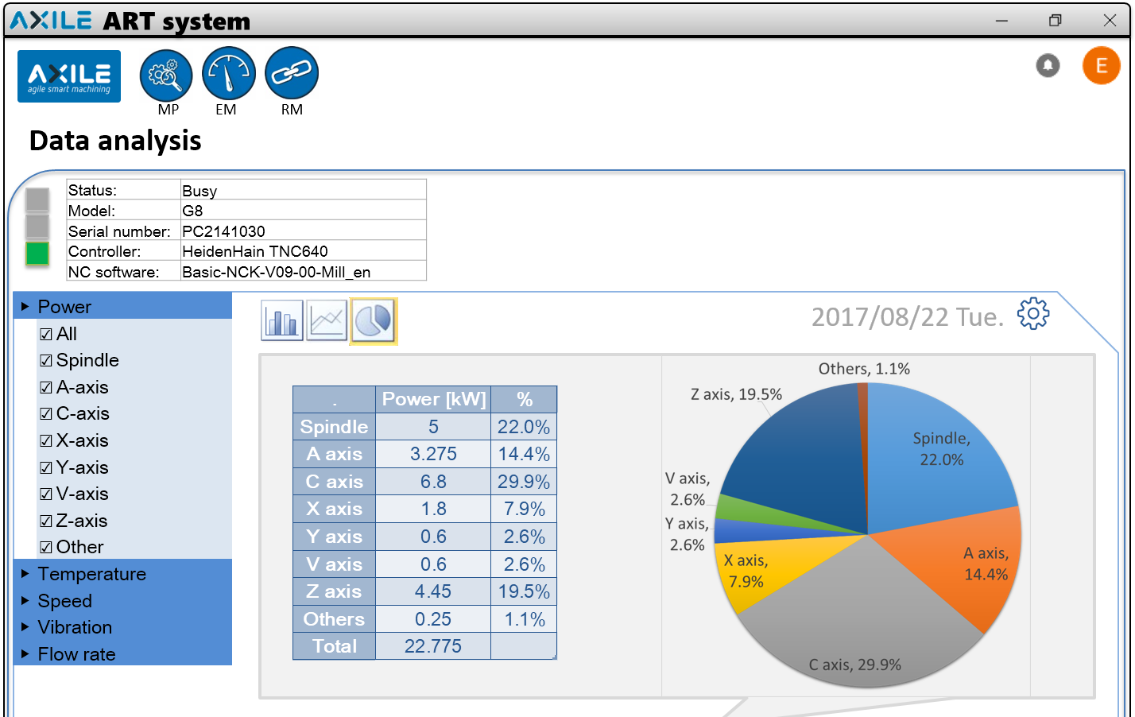
Data Analysis
Menu
Observation of power percentage

Slide 13
Data Analysis
User defined alarm rules
Process Energy Monitoring
Observation of axis power

Slide 14
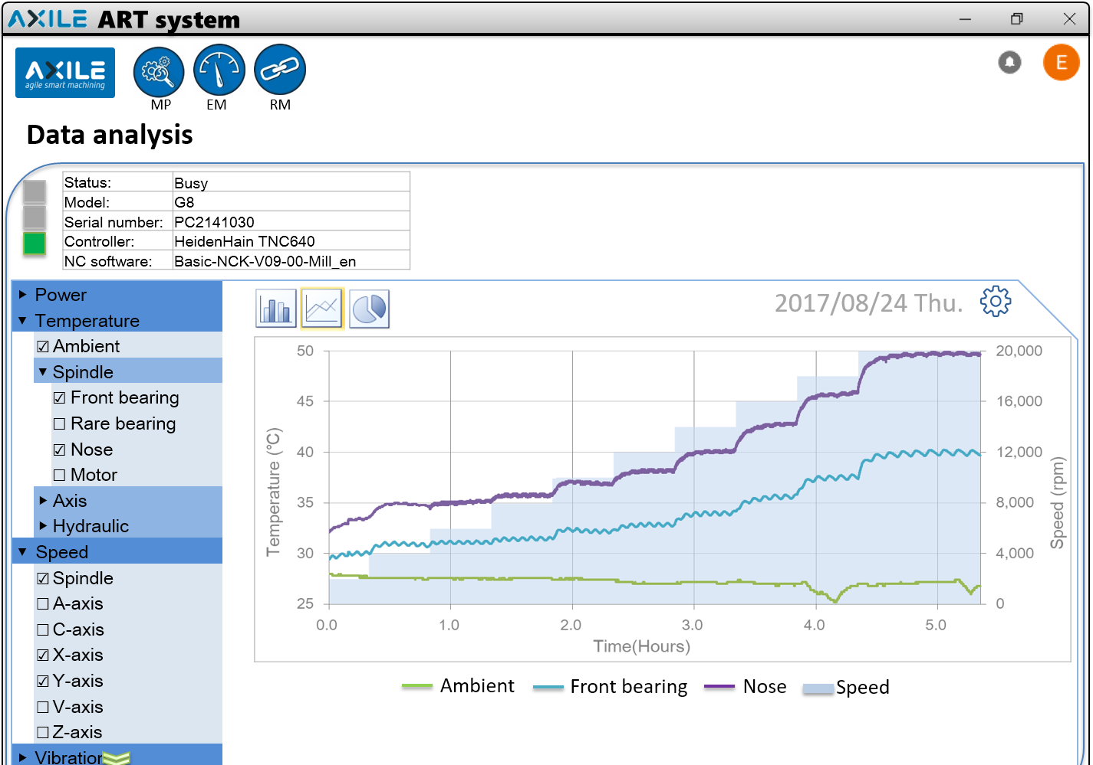
Data Analysis
Observation of spindle temperature

Slide 15
Lifetime Monitoring
Lifetime indicator

Slide 16
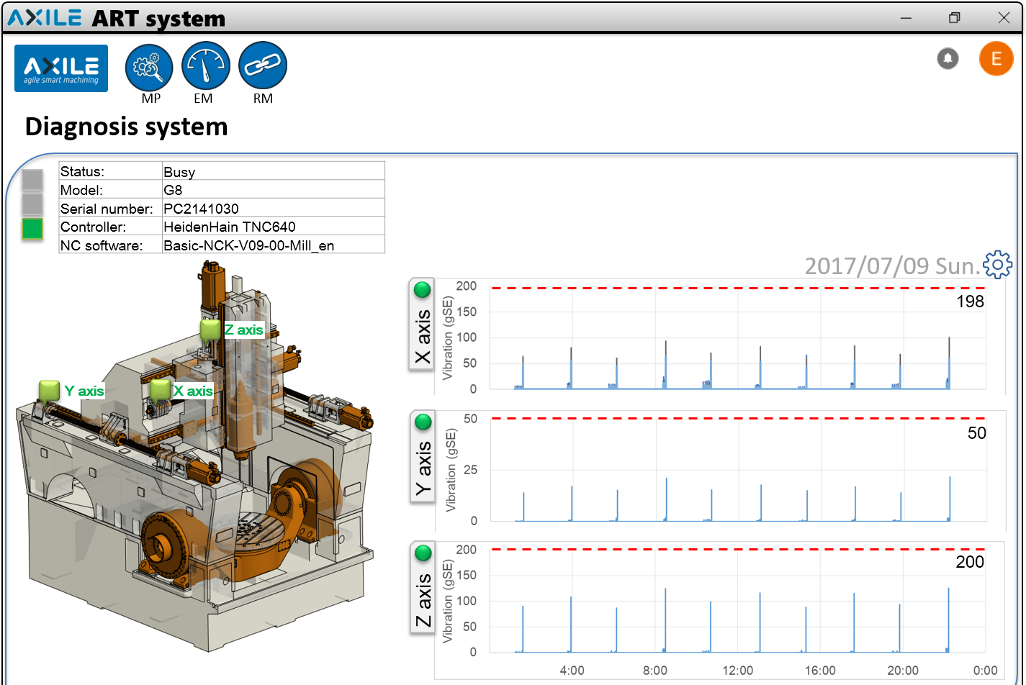
Diagnosis System
3 axis vibration analysis

Slide 17
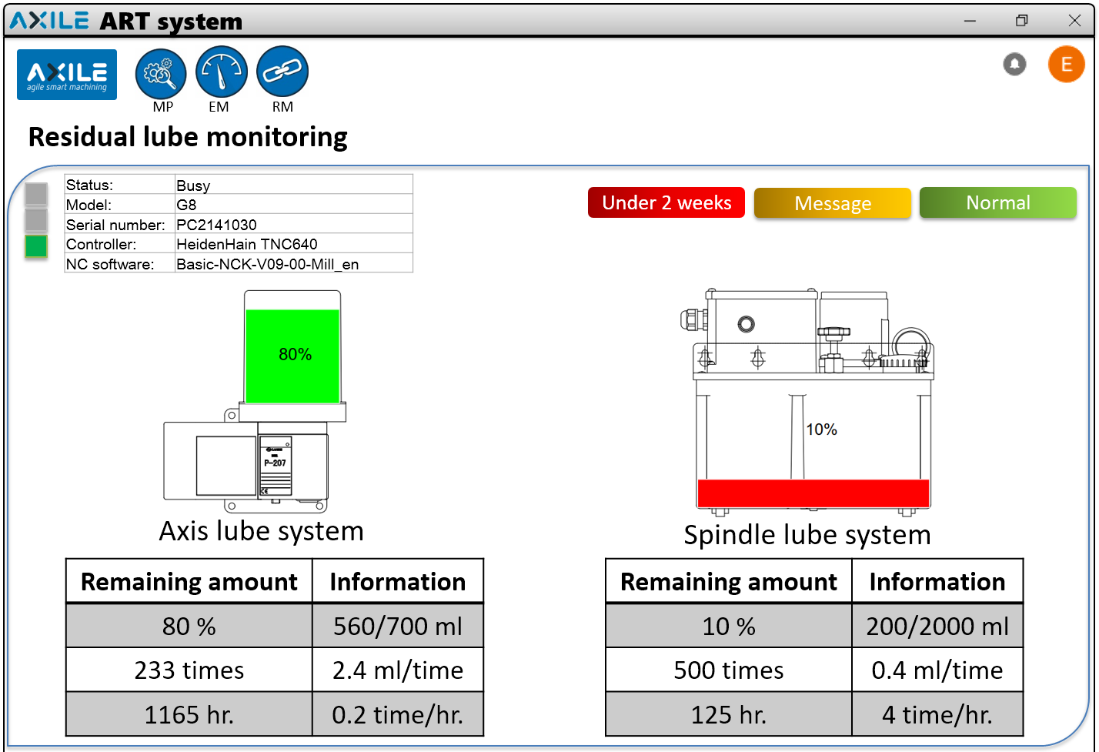
Residual Lube Diagnosis

Slide 18
Conclusion
High reliability product makes customers satisfied
ART completes the diagnosis and analysis on machine
In-time maintenance service
Management and planning assistance
High productivity

